Slide 1
Albuquerque
Campaign Finance System
Quick Start Guide

Slide 2

Guide Overview
Part 1 – Existing Filers Sign in
Part 2 – New Filers Registration
Part 3 – Using your account

Slide 3
Part 1 – Existing Filers Sign in

Slide 4
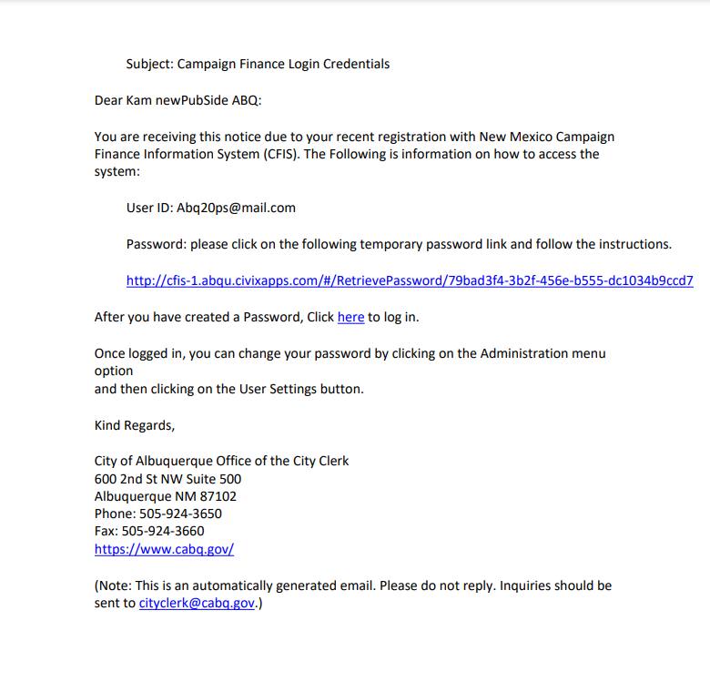
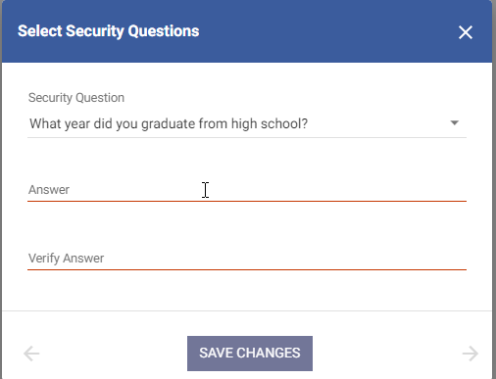
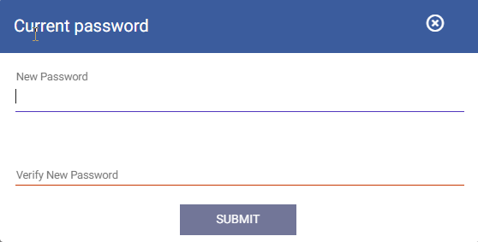
Part 1 Existing Filers Sign in – Account creation
Users already registered in the system with a valid email address will have received an email with a link to create credentials in the new system.
Your email address will serve as your username in the new system
Follow the Link to create a password in the email
System will prompt you to create answers to security questions and a new password.

Slide 5
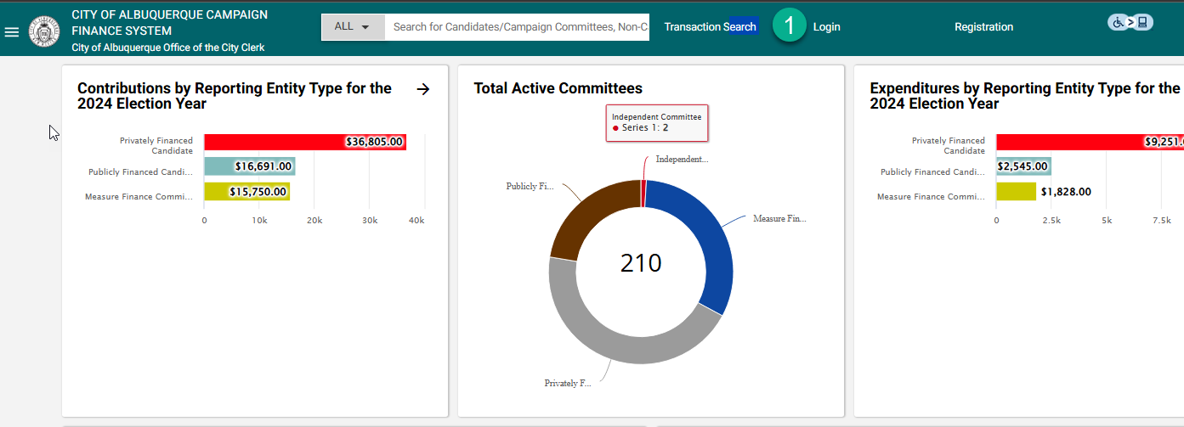
Part 1 Existing Filers Sign in – Login
Once you have created your security questions and password, you are ready to sign in from the public site. Follow the link to “Log In” from the top of the page.

Slide 6
Part 2 – New Filers Registration

Slide 7
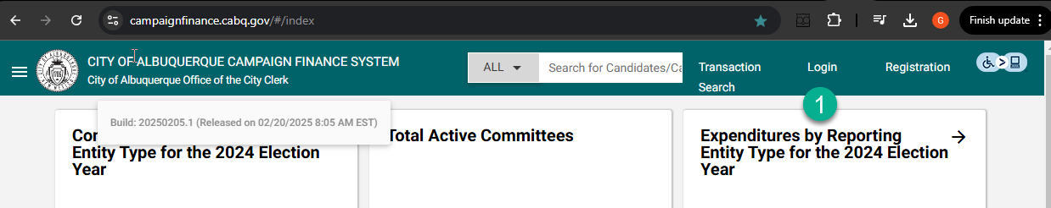
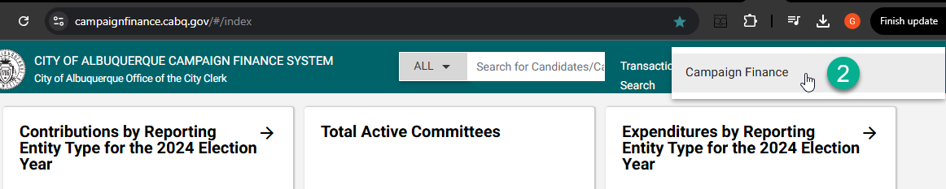
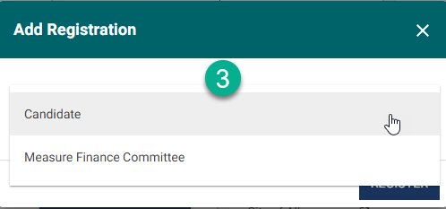
Part 2 New Filer Registration – Public Site
From the Public site, you will select “Registration”
Choose “Campaign Finance”
Choose Registration type “Candidate” or “Measure Finance Committee”

Slide 8
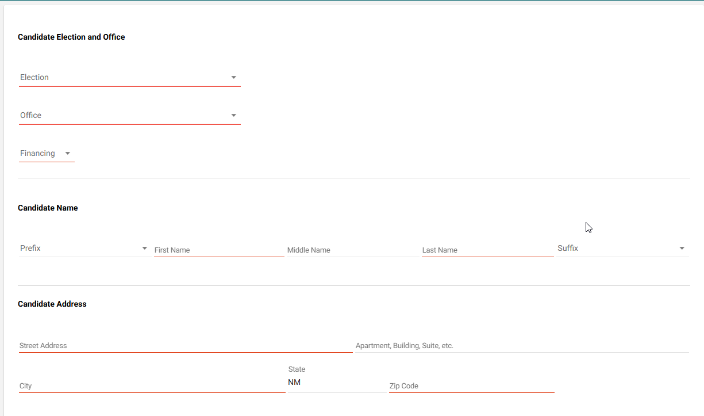
Part 2 New Filers Registration – Information
Complete User Information, Contact Information, and Address Info sections etc (Note email will be your username for login) and submit

Slide 9
Part 2 New Filer Registration – Credentials Email
After you complete registration and are approved by an admin, the system will deliver a credentials email where you will set security questions and create a password. Once this step is complete, you are ready to log in to the application.

Slide 10
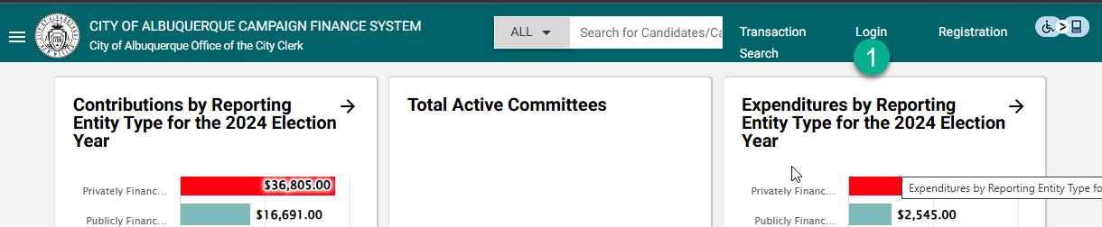
Part 2 New Filers Registration – Signing in
Once Credentials and Password are set, you can log into the application by navigating to the Albuquerque Lobbyist Reporting System Home page and selecting “Login”.

Slide 11
Part 3 – Using your account
Filers

Slide 12
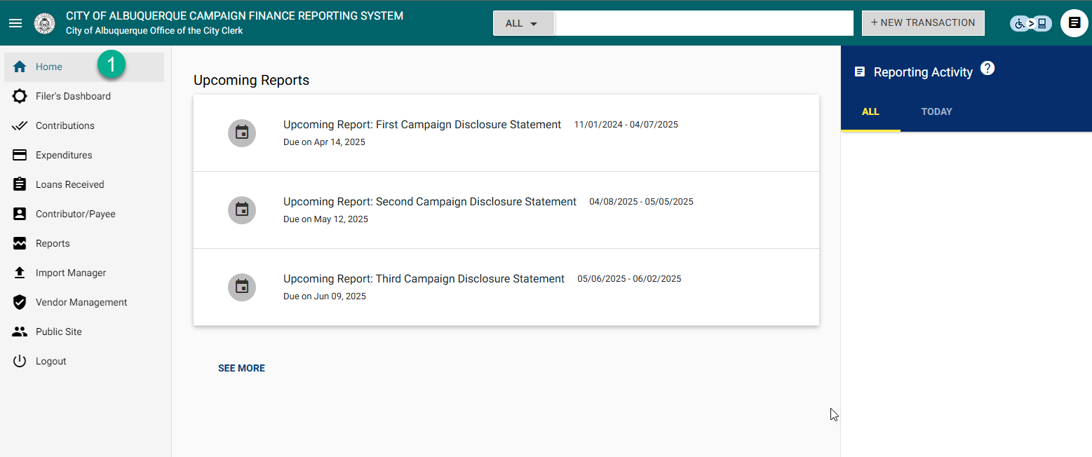
Part 3 Using your account (Filers) – Home screen
Once Credentials are set, you can log into the application by navigating to the Albuquerque Campaign Finance Reporting System Public page and selecting “Login”. The first screen you see is the Home Screen. Here the system will display important reminders like upcoming reports.

Slide 13
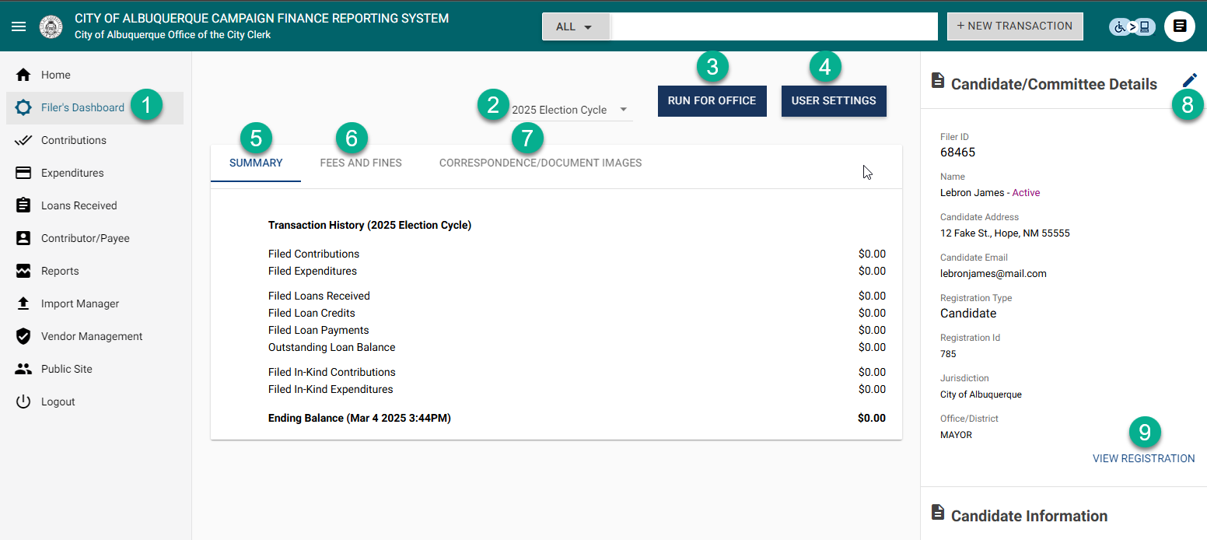
Part 3 Using your account (Filers) – Filer’s Dashboard
The next option in the menu is Filer’s Dashboard, which contains important information and account controls
You can view your selected Election cycles in the dropdown
“Run for office” - when visible, allows you to opt in to an upcoming election using the same account
User settings allows you to update password and security questions
Summary shows you a summary of your filed transactions
Fees and fines will display any fees/fines applied to your account.
Correspondence/Doc Images stores things like your registration emails. It also allows you to upload supplemental documentation.
Amend pencil – Use this to make adjustments to your registration info
View registration – Allows you to view your registration documents.

Slide 14
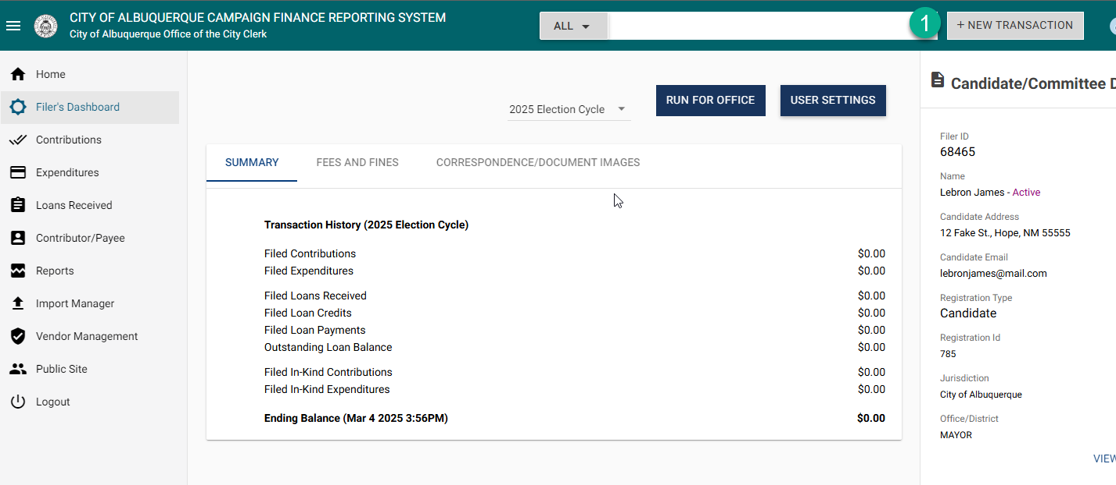
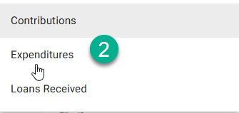
Part 3 Using your account (Filers) – Entering Transactions
On Filer’s Dashboard, select the +New Transaction button
On Expand, select the type (Contributions, Expenditures, Loans Received)

Slide 15
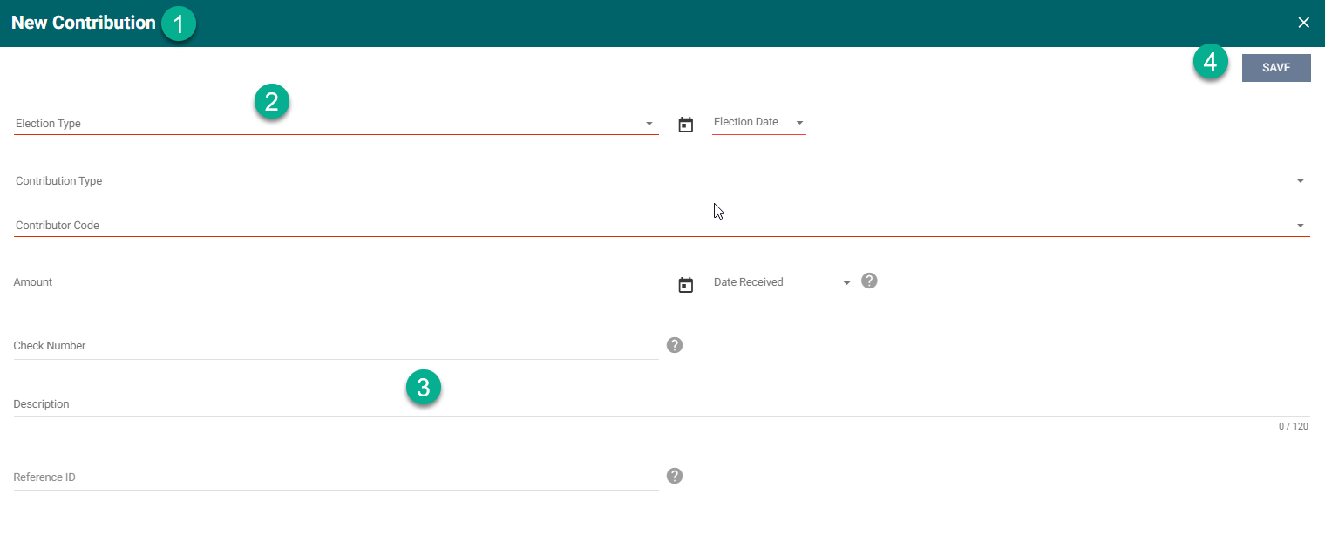
Part 3 Using your account (Filers) – Transaction Entry Modal
Transaction type – indicated in modal header
Required fields – will show underlined in RED
Optional fields will display with standard grey underlines
Don’t forget to SAVE after you have completed all Required fields and any Optional you choose!

Slide 16
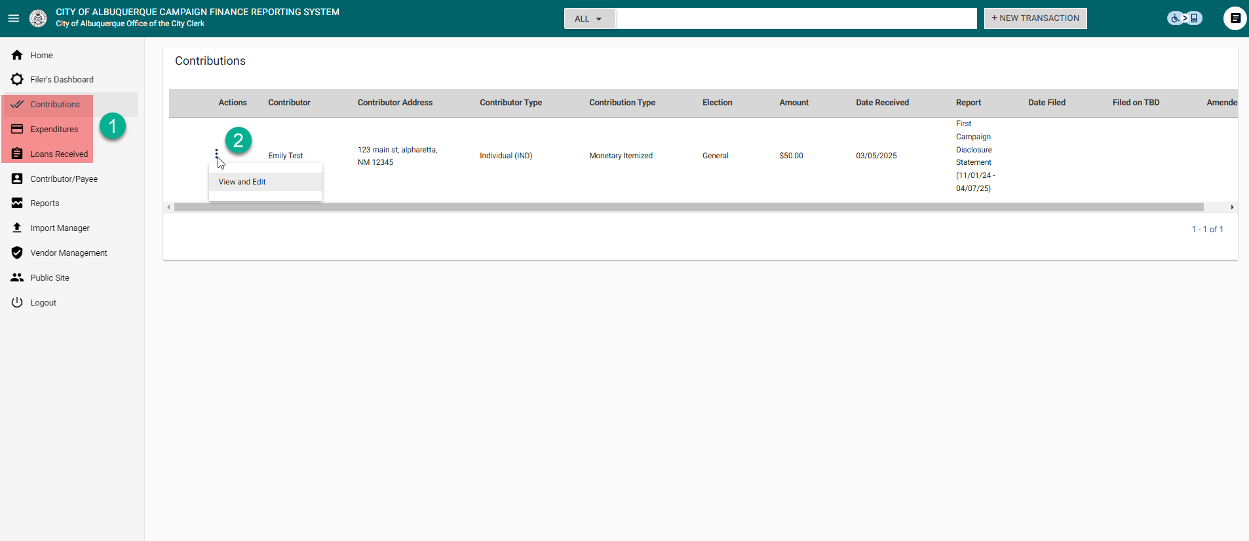
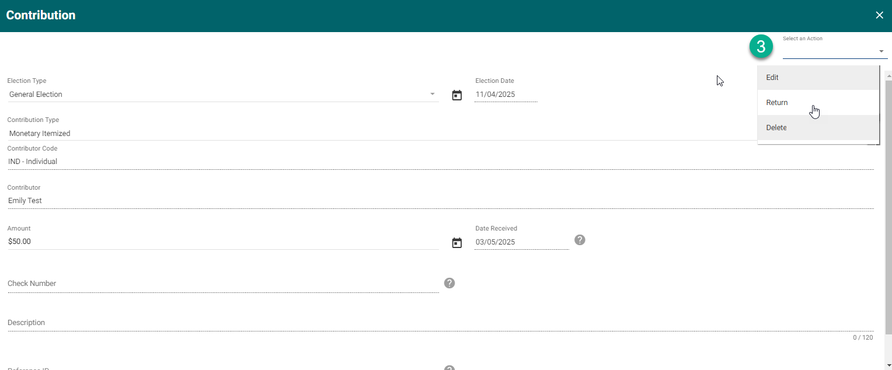
Part 3 Using your account (Filers) – Viewing and editing added transactions
Once you have completed adding a transaction, you can find it in the relevant section (Contribution, Expenditures, Loans Received)
To view and Edit, select the vertical ellipsis menu option next to the transaction.
When in view/edit mode for a single transaction, you can take actions like Edit, Return, Amend Loan payments, Forgiveness, and Delete by using the “Select an Action” dropdown in the top right corner of the modal.

Slide 17
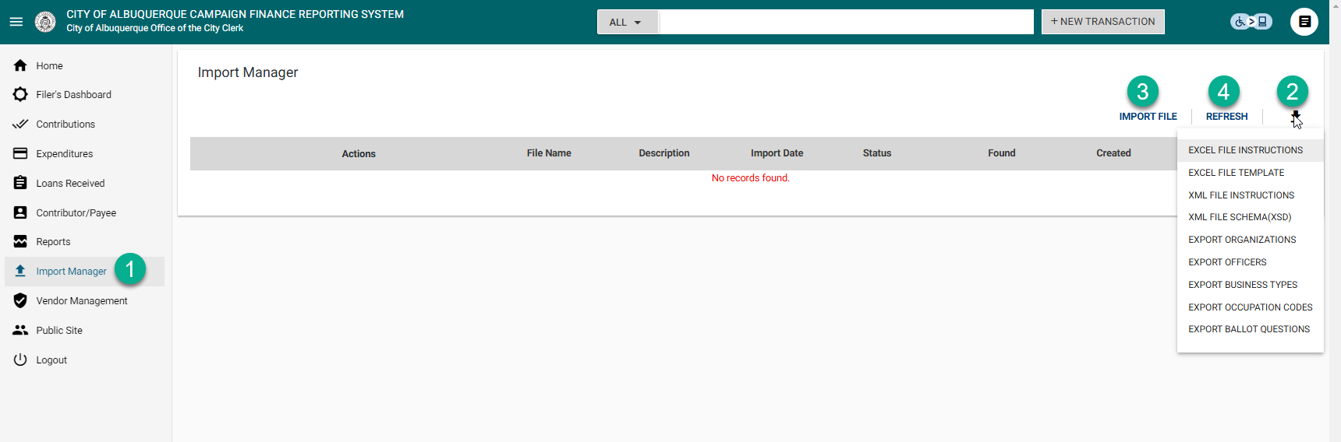
Part 3 Using your account (Filers) – Import Manager
If you wish to upload transactions in bulk, you can utilize the “Import Manager” tool (when available) found in the menu options.
On Import MGR screen, select the download button (top right) to see the list of documents available to download. This includes Instructions and templates which are to be utilized for proper formatting.
Once you have reviewed the instructions and completed entries into your downloaded template file, you can select the “Import File” button to upload.
Once the file has been selected and upload started, you can utilize the refresh button to check progress.

Slide 18
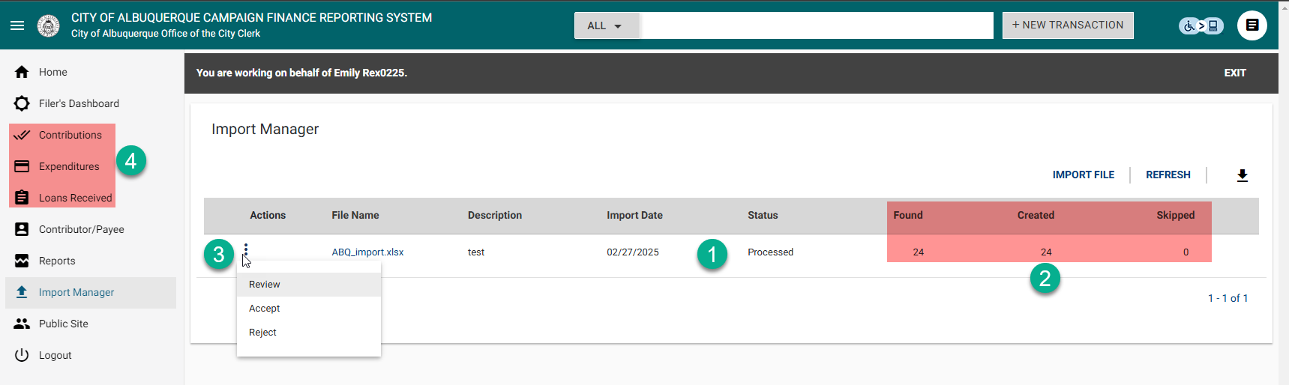
Part 3 Using your account (Filers) – Import Manager
Once the file is processed, the Status column will update.
The results of the import populate in the Found, Created, and Skipped columns
You can now take actions on the file once the upload process is complete. User can Review, Accept, Reject, or Reverse (once you have already accepted )the import file.
Once you have Accepted the import, your transactions from the import will appear in the relevant area for viewing.

Slide 19
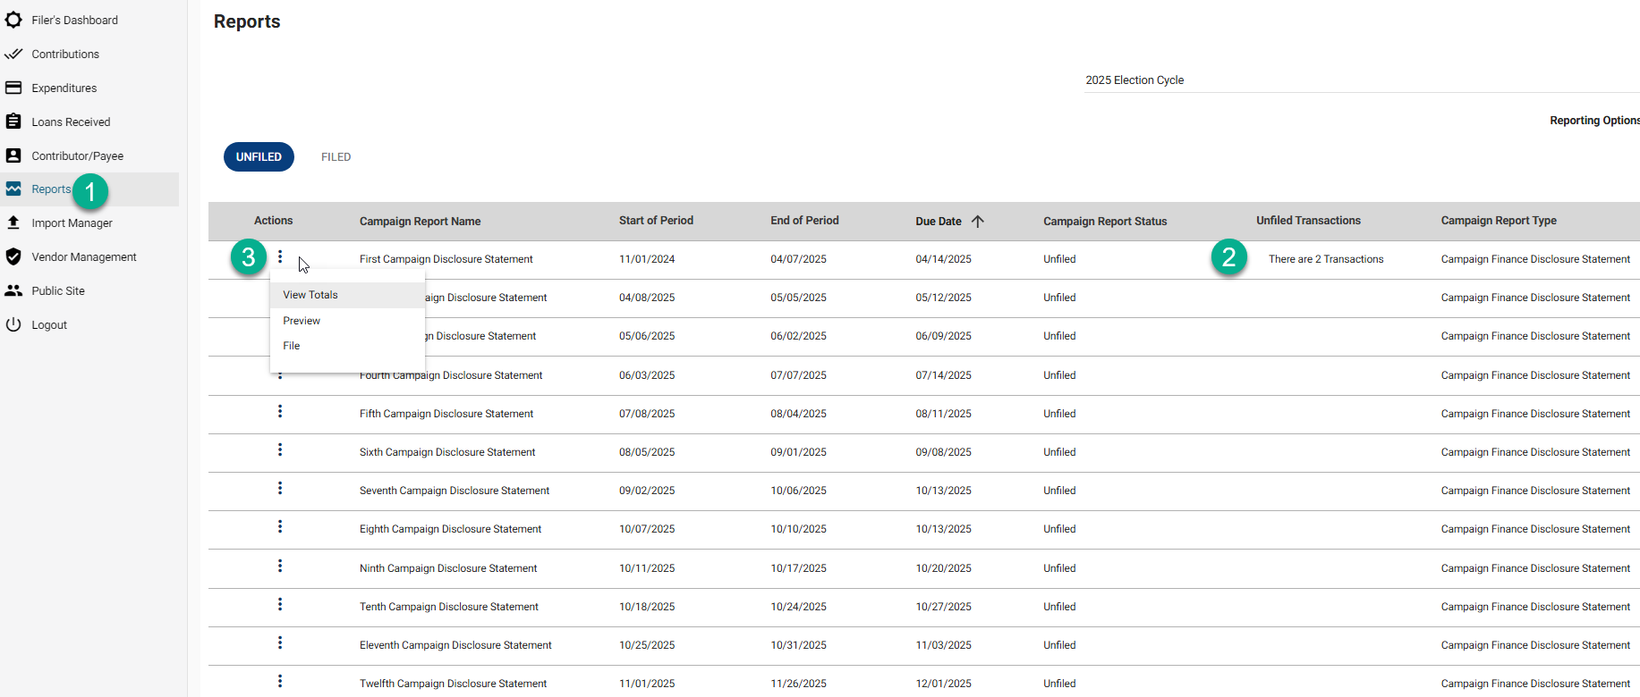
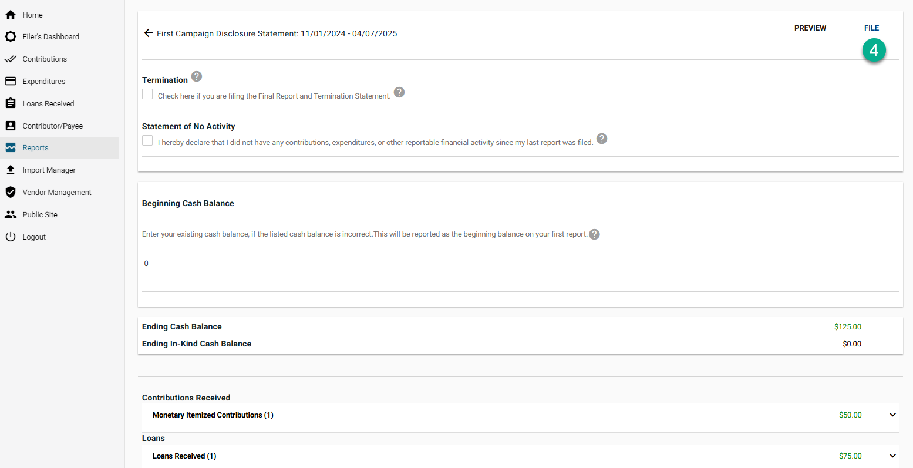
Part 3 Using your account (Filers) – Filing reports
When you are ready to file your report, navigate to the Reports page.
In the report grid, you will see report status and an indication of how many transactions fall on the given report.
Select the vertical ellipsis menu option next to the report you wish to file and select “File”. This will take you to the next screen.
On the filing screen, you will see a preview of your entries as well as the option to select “Statement of no activity” if you are filing a report without any transactions. Select the “File” button (top right) when you are ready to proceed. Transactions will only appear on the public site after you have filed a report.

Slide 20
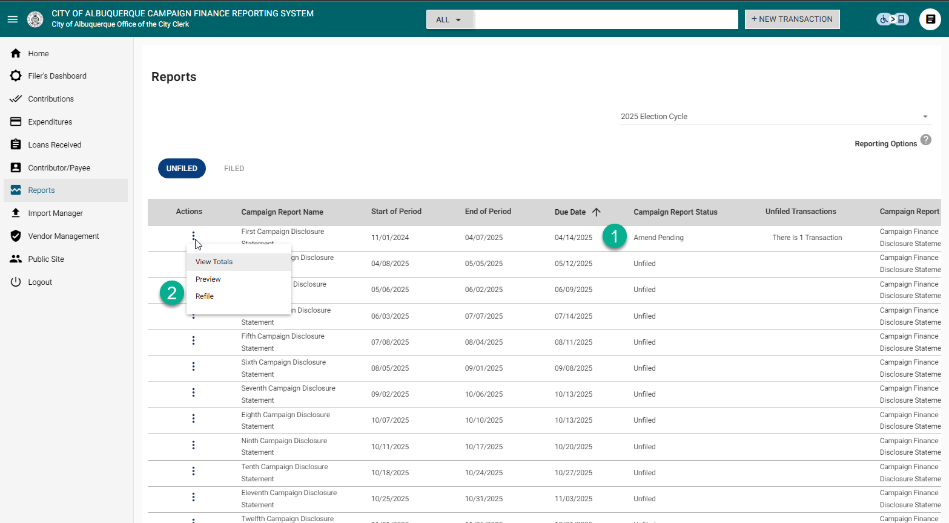
Part 3 Using your account (Filers) – Amending reports
If you file a report and later go back and change or add a transaction to that report, the system will update the Status of the report to “Amend pending”.
To file an amended version of a report, select the Vertical Ellipsis menu for the report you wish to refile and choose the option to “Refile”. This will take you through the same filing screen previously mentioned.

Slide 21
Thank You

